Slide 1
Marcin Postuła (my father)
By his son Filip P

Slide 2
HE WAS BORN
He was born on November 5, 1974 in Iłża - a beautiful, small town in the south of Masovia. His parents,Jacek and Teodora, had a farm. Dad has two siblings, brother Leszek and sister Maria.

Slide 3
HIS EDUCATION
Marcin started his education in the local kindergarten and later he finished primary school and general secondary school in Iłża. He finished from law and management studies. He studied at several universities, including in Radom, Lublin and Warsaw.

Slide 4
HE MOVED
In 2000, he moved permanently to Warsaw and started working in a law firm.

Slide 5
MARCIN MARRIED
In 2003, my father married my mother Monika, with whom he has two children, Julia and me.We have one amazing dog.

Slide 6
DEVELOPMENT JOB
Since 2003, he has been working in the development industry and is involved in construction.

Slide 7
MY DAD NOW
Currently, my dad is a director in one of the large apartment building companies all over Poland. Dad likes his job and sometimes goes on a business trip. When he comes back, he tells me about his job and other cities. Last year we managed to go away together. We spent a week in Wrocław, dad went to work and we visited the city.

Slide 8
THE ACTIVE MAN
Dad is an active man, he likes to travel with us and does sports, especially skiing.

Slide 9
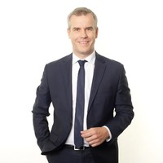
My dad in the suit in the work

