Slide 1
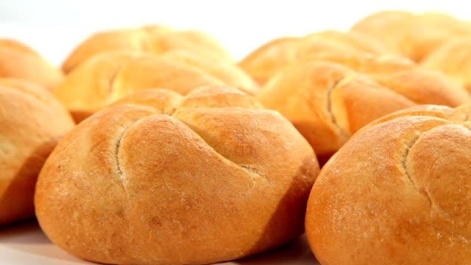
Tasty bread rolls

Slide 2
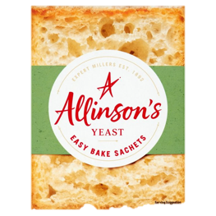
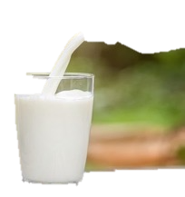
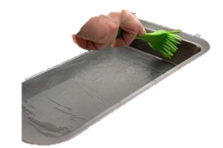
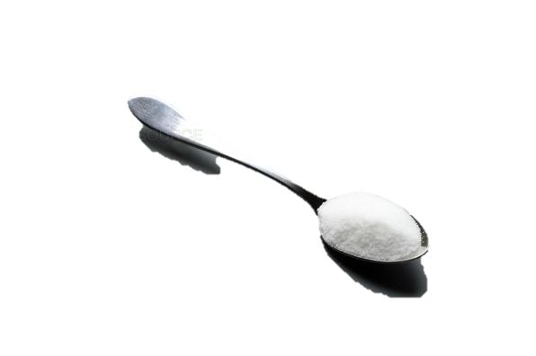
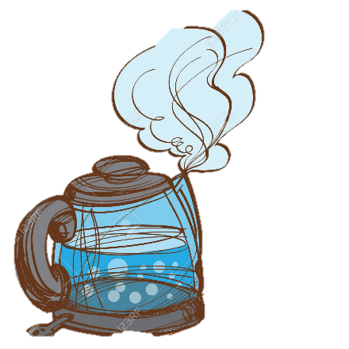
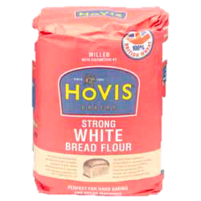
You will need…
450g strong white bread flour
1 teaspoon salt
2 teaspoons dried easy-blend yeast
300ml warm water that has been boiled
2 tablespoons vegetable oil
Milk
A greased baking tray

Slide 3
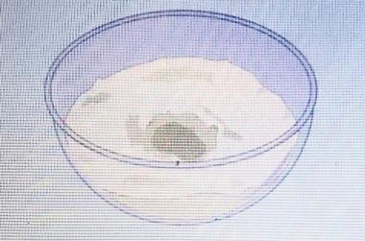
Step 1
Sift the flour and salt through a sieve into a large bowl. Add the yeast and stir it in, then make a hollow in the middle of the flour.
*Brown bread rolls are made with wholemeal bread flour instead of white flour.

Slide 4
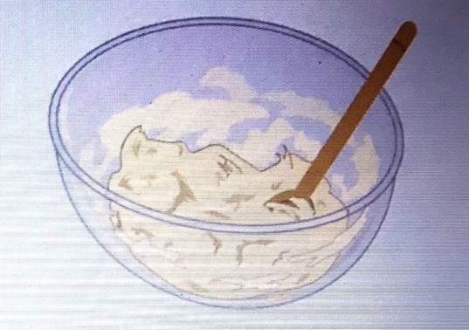
Step 2
Pour the warm water into a jug and add the oil, then pour the mixture into the hollow. Stir everything with a wooden spoon to make a soft dough.

Slide 5
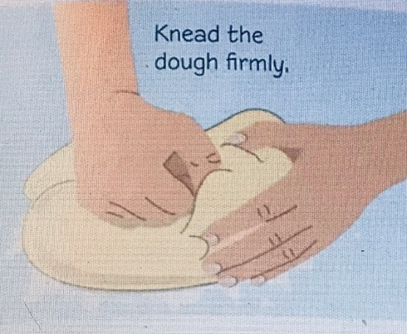
Step 3
Dust a clean work surface with flour. Put the dough onto the work surface. To knead the dough, press your knuckles into it. Push it away from you.

Slide 6
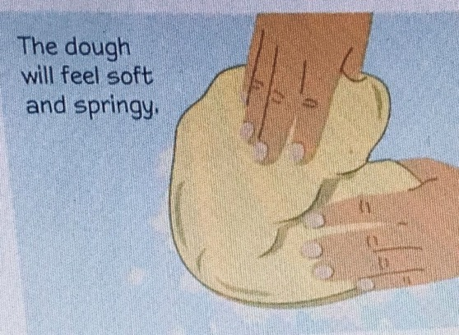
Step 4
Fold the dough in half and turn it around. Push it away from you again, then fold it in half and turn it around. Knead the dough for 10 minutes.

Slide 7
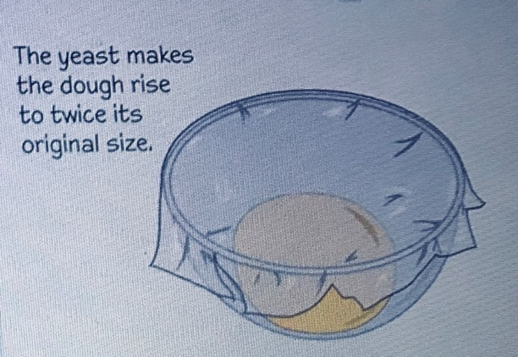
Step 5
Put the dough into a clean bowl and cover the bowl with plastic foodwrap. Then, leave the bowl in a warm place for 1 hour and 30 minutes to rise.

Slide 8
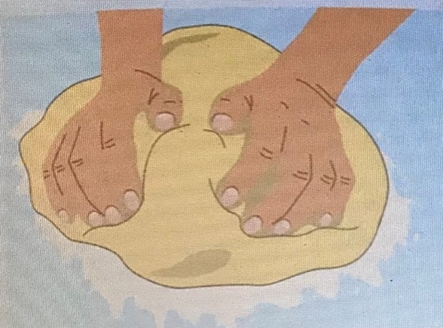
Step 6
Sprinkle more flour onto the work surface, then put the dough onto it. Knead the dough again for a minute, to squeeze out any bubbles.

Slide 9
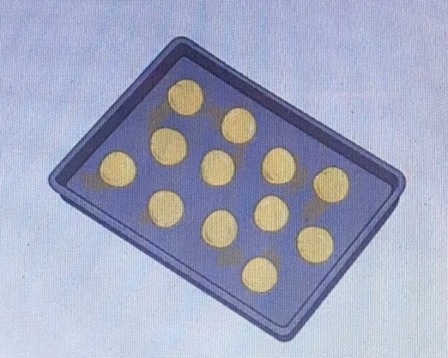
Step 7
Break the dough into 12 pieces. Roll the pieces into balls and put them onto a greased baking tray with spaces between them.

Slide 10
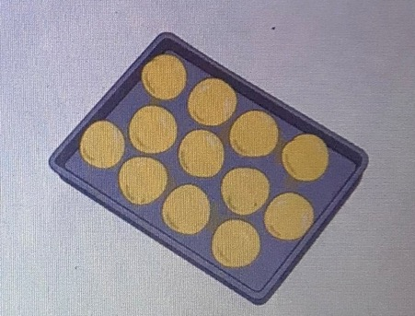
Step 8
Leave the rolls to rise in a warm place for about 40 minutes. While they are rising, heat your oven to 220ºC, gas mark 7.
*The rolls won´t rise after they have been in the oven because the yeast is killed by the heat.

Slide 11
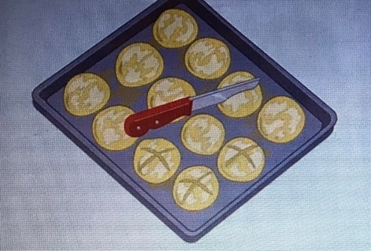
Step 9
Brush a little milk over the tops of the rolls. Then, make crosses in the top of some of them by carefully cutting into the dough with a sharp knife.
Optional: You could sprinkle poppy or sesame seeds, rolled oats or a little grated cheese over the tops of the rolls BEFORE you put them in the oven.

Slide 12
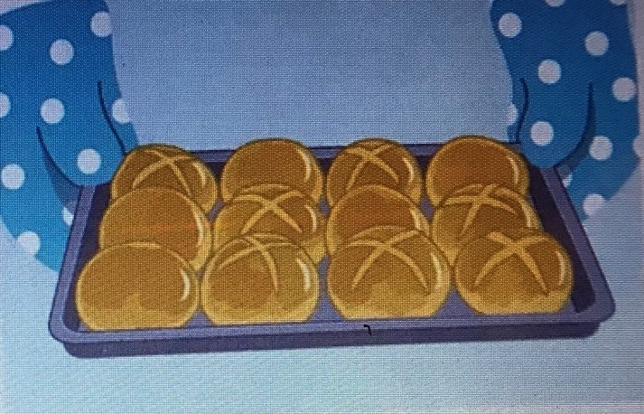
Step 10
Bake the rolls for 12-15 minutes. Wearing oven mitts lift the tray out of the oven. After two minutes, move the rolls onto a wire rack to cool.

Slide 13
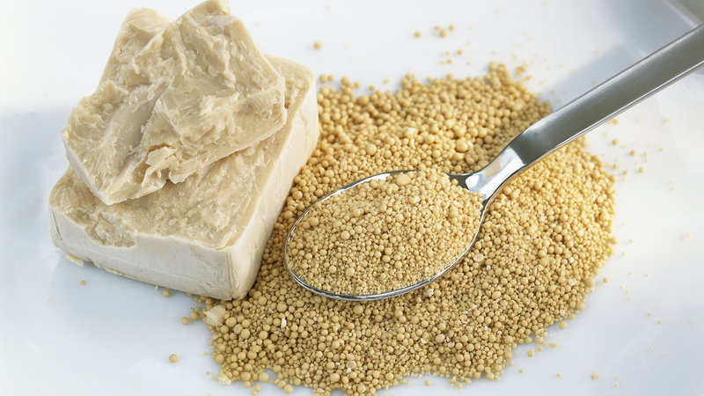
Do you know yeast doesn´t look very lively, but it´s actually alive?
Yeast is made up of teeny tiny living things called micro-organisms. It feeds off a chemical in the flour called starch. As it does this, it gives off a gas that gets trapped in the dough, making it rise. When you break open a bread roll, you can see where the bubbles of gas were trapped inside.
Hungry fungi!!!

